Slide 1

Keystroke Biometric Identification
By Niyati Jain

Slide 2

About the Project
Objective: The project aims to study keystroke (typing patterns) through digraphs of different users in order to detect fraudulent test takers.
The project compares the results of the XGBoost classification model and a Siamese Network implemented using a Deep Learning model called TypeNet.
Notes:
remove classify different user profiles

Slide 3
Motivation for the Project
Every year, 2.3 million students take the TOEFL and 70,000 take the GRE exam for schools in more than 90 countries through ETS.
The Facial, Voice and Keystroke Biometrics help uphold ETS’s reputation which is built on trust and credibility and not merely on test scores.
This ‘Keystroke Biometric Identification’ project addresses a critical aspect of maintaining exam integrity - detecting fraudulent test-takers.
Notes:
Combine 2nd and 3rd point

Slide 4
Project Life-Cycle
Understanding the Dataset
Data
Pre-Processing
Exploratory Data Analysis
XGBoost Classifier
Siamese TypeNet Network

Slide 5
Project Life-Cycle
‘Understanding the Dataset’
Data Pre-processing
Exploratory Data Analysis
XGBoost Classifier
Siamese TypeNet Network

Slide 6
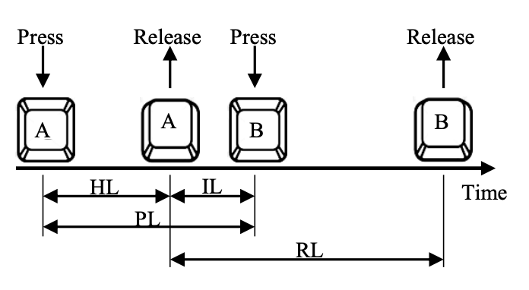
Understanding the dataset
The dataset has been taken from ‘Observations on Typing from 136 Million Keystrokes’.
It has a total of 168,000 users who are each given 15 sentences chosen randomly from a set of n sentences.
The press and release time for each keypress in the original dataset are used to calculate four latencies for every digraph.
The four latencies are:
Inter-Key Latency (IL): The time between releasing a key and pressing the next key
Hold Latency (HL): The time between pressing a key and then releasing the same key
Press Latency (PL): The time between two consecutive press events
Release Latency (RL): The time between two consecutive release events
Digraphs are pairs of any two consecutive characters typed by the user.

Slide 7
Project Life-Cycle
‘Data Pre-Processing’
Understanding the Dataset
Exploratory Data Analysis
XGBoost Classifier
Siamese TypeNet Network

Slide 8
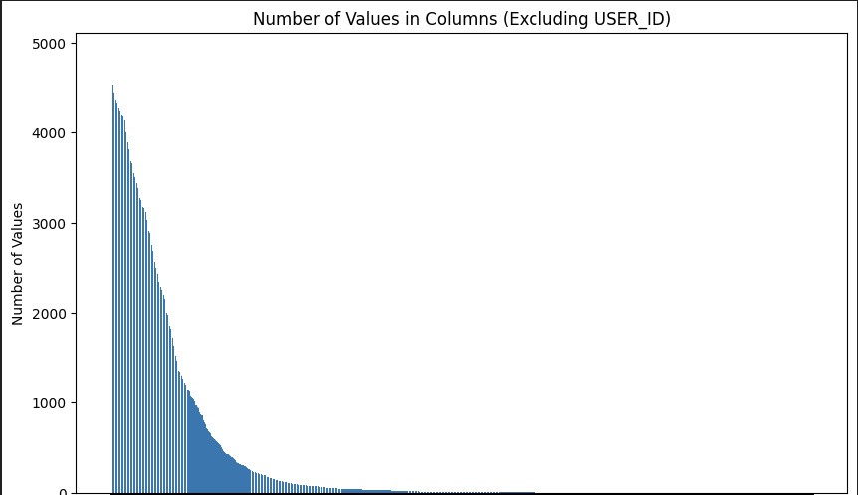
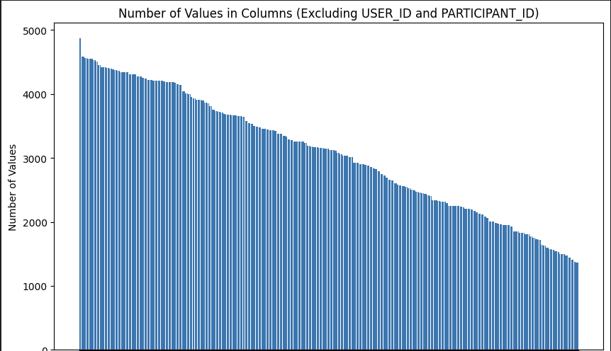
Data Pre-processing
Dropped 30,864 (34.34%) columns with empty spaces or special characters as digraphs.
Dropped 54,576 (92.47%) columns having more than 85% of null values.
Notes:
Make it short
Include biometric

Slide 9
Data Preparation
The metrics in the dataset are split into two parts on the column ‘USER_ID’ by:
The first 7 sentences typed by that user denoted by user_id_1
The next 8 sentences typed by that user denoted by user_id_2
The final dataset 1 has 13,678 users and 27,356 rows (two rows for each user id).
There are 4441 columns in the dataset in the form ‘Digraphs_latency_statistic’.
A new dataset having combinations of user pairs is created:
Same user pairs (e.g. 21833_1 and 21833_2) have label set as 0
Different user pairs (e.g. 21833_1 and 12871_2) have label set as 1.
These combinations are mapped to the original dataset for features and then the differences of their squares are recorded while the label column determines the label.

Slide 10
Project Life-Cycle
‘Exploratory Data Analysis’
Understanding the Dataset
Data
Pre-processing
XGBoost Classifier
Siamese TypeNet Network

Slide 11
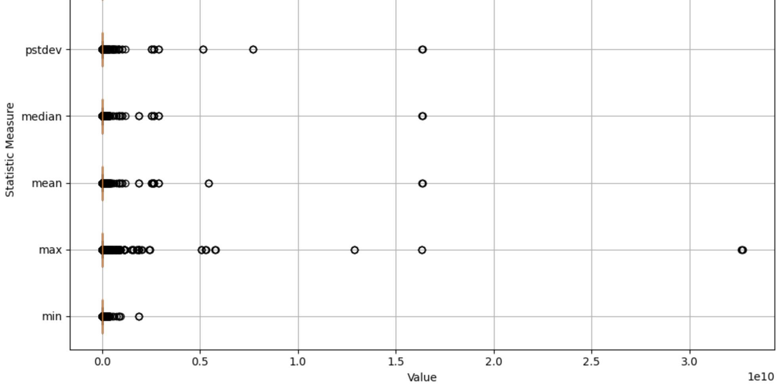
Distribution of overall statistic measures
The graph shows the distribution of individual statistic measures covering all the users and latencies.
Capped the outliers more than 0.5 X 10⁹ to 0.5 X 10^{9.}
Notes:
Make it short
Include biometric

Slide 12
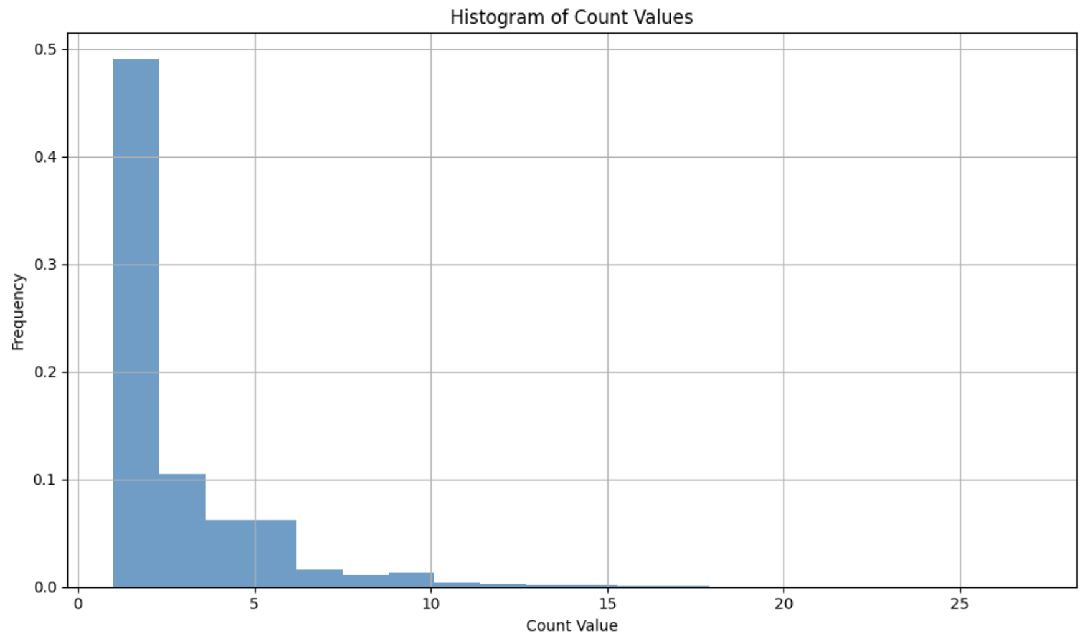
Frequency of digraphs in sentences typed by the user
The graph shows the frequency of digraphs in sentences typed by the user through the values in the columns having the statistic measure as ‘count’.

Slide 13
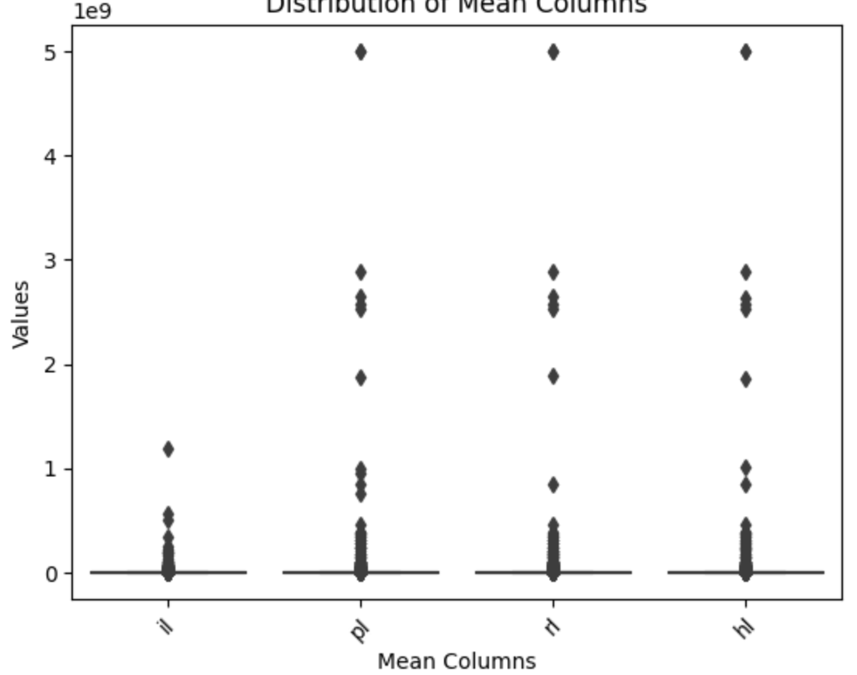
Distribution of the mean values of each latency
The graph shows the distribution of the mean values across various latencies for all users through the values in the columns having the statistic measure as ‘count’.

Slide 14
Project Life-Cycle
‘XGBoost Classifier’
Understanding the Dataset
Data Pre-Processing
Exploratory Data Analysis
Siamese TypeNet Network

Slide 15
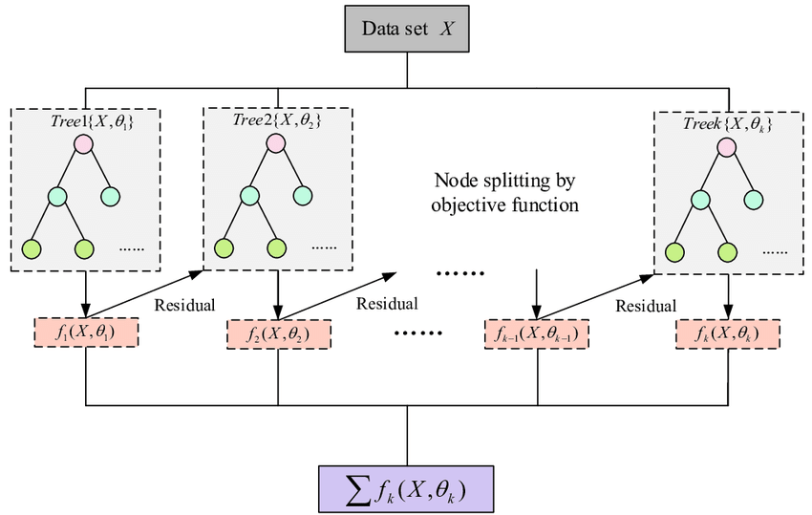
XGBoost (Extreme Gradient Boosting) Model
XGBoost is an emsemble machine learning algorithm that combines multiple decision tree models to create a strong predictive model.
XGBoost utilizes a gradient boosting framework, where each subsequent decision tree is built to correct the mistakes made by the previous trees, resulting in a more accurate and robust model.

Slide 16
Data Pre-Processing
I performed the below pre-processing techniques and tested them individually using the XGBoost classifier:
Null Value Analysis
Imputing null values as 0
Imputing null values as mean
Imputing null values as median
Log Value Analysis
Standardization
Normalization
I derived the best results after taking log of all values, then imputing the null values with the mean of the values in the columns and then applying normalization using MinMax Scaler.

Slide 17
Evaluation Metrics
Accuracy: The proportion of correctly classified instances out of the total instances, indicating the overall correctness of the model's predictions.
Precision: The ratio of true positive predictions to the total predicted positives, representing the model's ability to accurately identify positive instances among its predictions.
Recall: The ratio of true positive predictions to the total actual positives, indicating the model's ability to correctly identify positive instances among all actual positives.
Equal Error Rate (EER): The point at which the false acceptance rate (FAR) is equal to the false rejection rate (FRR), providing a balanced measure of classification performance in biometric verification systems.
False Positive Rate (FPR): The ratio of false positive predictions to the total actual negatives, showing the rate at which, the model incorrectly identifies negatives as positives. This metric holds paramount significance as an erroneous identification of a fraudulent test-taker could potentially result in significant expenditures of time, resources, and effort.

Slide 18
Results
Validation Set:
Test Set:
Accuracy: 67.57%
Precision: 71.5%
Recall: 58.7%
Equal Error Rate (EER): 35.71%
False Positive Rate(FPR): 35.71%
Confusion Matrix:
Accuracy: 68.59%
Precision: 70.5%
Recall: 60.4%
Equal Error Rate (EER): 34.95%
False Positive Rate(FPR): 34.94%
Confusion Matrix:
 | Predicted 0 | Predicted 1
Actual 0 | 1233 | 377
Actual 1 | 665 | 939
 | Predicted 0 | Predicted 1
Actual 0 | 1219 | 378
Actual 1 | 631 | 985
Notes:
Add precision Recall
Add a slide explaining the evaluation metrics: talk about why fp is imp

Slide 19
Project Life-Cycle
‘Siamese TypeNet Network’
Understanding the Dataset
Data Pre-Processing
Exploratory Data Analysis
XGBoost Classifier

Slide 20
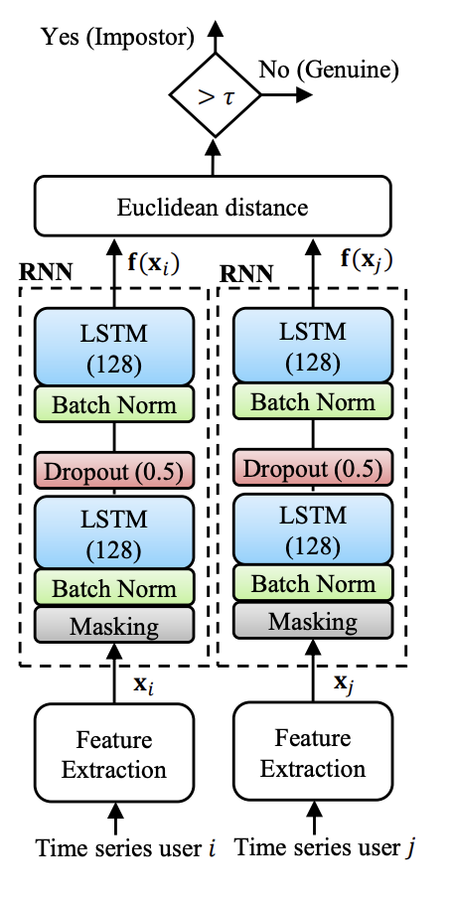
Siamese Network
A Siamese network is a type of neural network architecture that uses twin networks with shared weights to learn similarity between inputs.
A pair of user inputs (e.g. 21833_1 and 21833_2 or 21833_1 and 27567_1) are fed as inputs to the two RNN models.
The embeddings obtained after training the models is uniquely able to identify each user and is further used for classification.

Slide 21
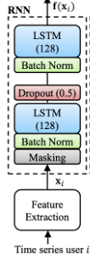
TypeNet Model Architecture
LSTM Layer: An LSTM layer (Long Short-Term Memory) in a neural network processes sequential data by selectively remembering and forgetting information over time, allowing it to capture and utilize long-range dependencies in the input sequences.
Batch normalization layer: It normalizes the activations along the batch dimension to improve training stability and speed up convergence.
Dropout Layer: It randomly sets a fraction of input elements to zero during training with a probability of 0.5. Dropout helps prevent overfitting by reducing the interdependencies between neurons.
Notes:
Condense this

Slide 22
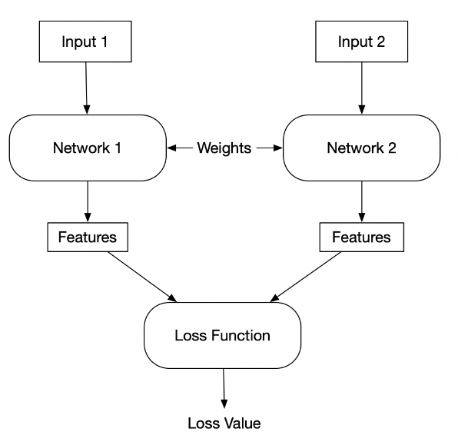
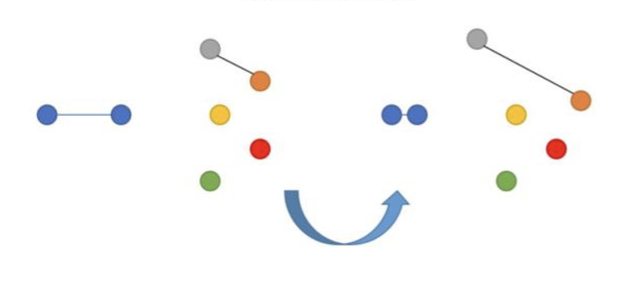
Contrastive Loss
The model learns through Contrastive Loss.
It is a loss function that encourages similar inputs to be embedded close together in the feature space while pushing dissimilar inputs further apart.
Dissimilar inputs
similar inputs
Contrastive
Notes:
Change visuals for contrastive and triplet loss

Slide 23
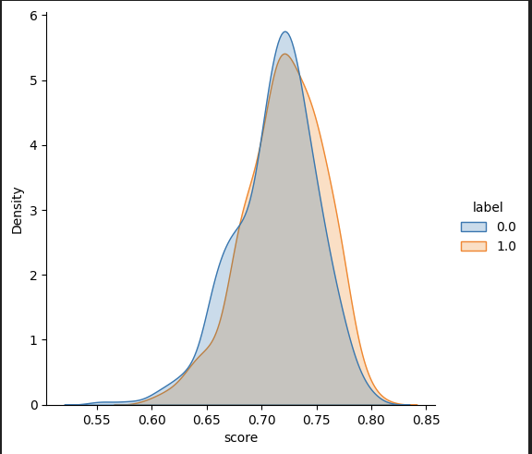
Results
The embeddings obtained on the validation set after training the Siamese Model were compared using the cosine similarity score:

Slide 24
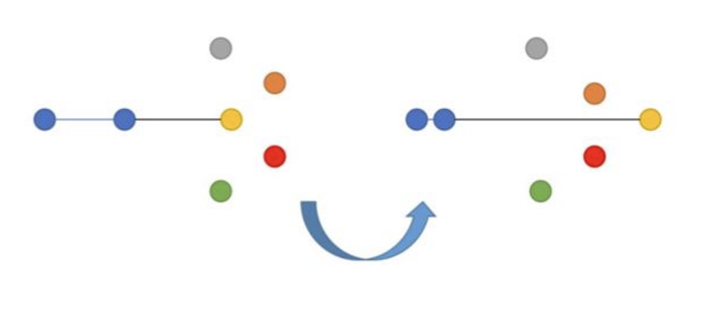
Triplet Loss
The model learns through Triplet Loss.
It is a loss function that minimizes the distance between an anchor sample and a positive sample while maximizing the distance between the anchor sample and a negative sample in the feature space.
Input 3
Network 3
positive sample
negative sample
anchor
Features
Triplet
Notes:
Change visual
Say it’s currently wip

Slide 25
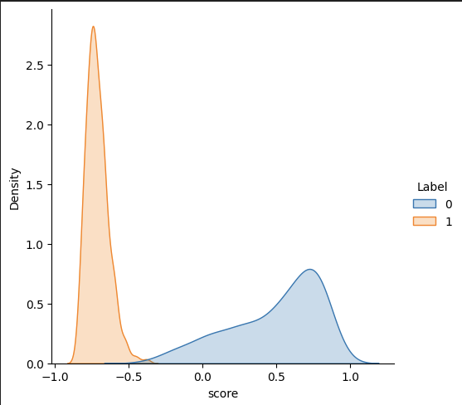
Results
The embeddings obtained on the validation set after training the Siamese Model were compared using the cosine similarity score:

Slide 26
